Slide 1
Fall Update 3
Dev Bhatia
Ultrafast Optics Laboratory
Boston University

Slide 2
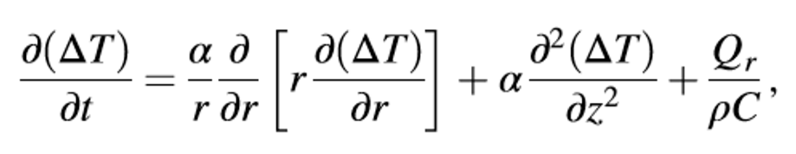
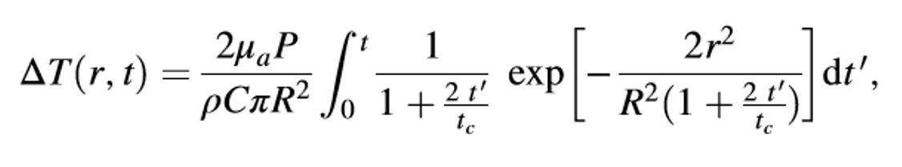
Theoretical Calculation of the ADTR [1]
Eq. 1 –
Mathematical Model of Heat Conduction Equation
Eq. 2 –
Equation 1 solved using a Gaussian approximation. ΔT obtained in consideration of the thermal lens effect
The thermal lens effect occurs when the laser beam is absorbed in the focusing region
Equation 2 predicted a linear relationship between the laser power and ΔT.
This deduction was confirmed via an open pipette method to measure the ΔT directly
980-nm wavelength infrared laser irradiation

Slide 3
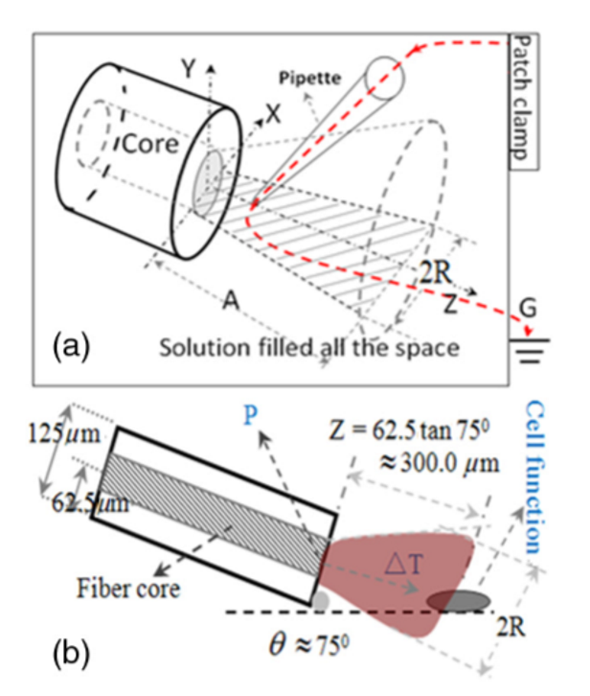
Open Pipette Method for ADTR Measurement
Rapid temperature measurement technique at the micron scale
Carried out by using a microamp current amplifier
Synchronized laser irradiation would cause a local temperature change
This would induce a resistance variation in the pipette
The measured pipette resistance was calibrated as a function of the ADTR

Slide 4



Variable Considerations
μa = 73.9 cm^-1 Optical Absorption Coefficient
R = 93.41 μm Beam waist at axial distance
z = 164.56 μm Axial Distance
tc = .01523 s Characteristic time of the thermal lens
P = .009999 W irradiation laser power, obeys Beer-Lambert law with the initial laser power Po
κ = 0.6 W/mK thermal conductivity
ρ = 1000 kg/m^3 density of water
c = 4188 J kg^-1 K^-1 heat capacity
r = 25 μm radius of the fiber core
ρ = resistivity determined by the open pipette
γ = conductance of pipette
T = temperature
γo = solution conductance at To
αT = temperature coefficient of solution conductance

